Slide 1
Project Pin Pointer

Slide 2
Business Problem Section

Slide 3
You’re a businessman and you think of starting your own business. You want to open your office, restaurant, coffee shop. You want to give your special touch to the industry.
* Gain money more efficiently.
* Ensure the survival of your business.

Slide 4
For example to open a Coffee Shop, certain condition should be met like cheap rent, enough density population . However, there are other factors like competition. People preference, etc.

Slide 5
In this project we will be focusing on certain keys that we think will help anyone start his own successful business

Slide 6
We will be focusing on two keys factors:
Density of similar business
Rating of each one

Slide 7
I have chosen to establish the project of opening a new restaurant. This project will aim to provide the investor with the best place possible to open his restaurant and even choose the speciality he is going to serve.

Slide 8
Data Section

Slide 9
What is our data source?
FourSquare
Kaggle

Slide 10
What will we use Foursquare for?

Slide 11
Getting popular venues
Getting their ratting.
Getting their specialitise.
Information about the traffic in those neighborhoods.

Slide 12
What will we use Kaggle for?

Slide 13
We have downloaded a dataset containing ZIP codes and geographical coordinates for each address in Singapore.
This data will be used later on with the foursquare plateform. This will help us locate popular venues( Coffee, Restaurants, offices. Etc), get their ratting, their menus, etc.

Slide 14
This dataset contains over 25 000 lines and 7 non duplicated columns.
* Postal code.
* Latitude
* Longitude
* Full address
* Street address
* Building name
* Districts

Slide 15
Resualt Section

Slide 16
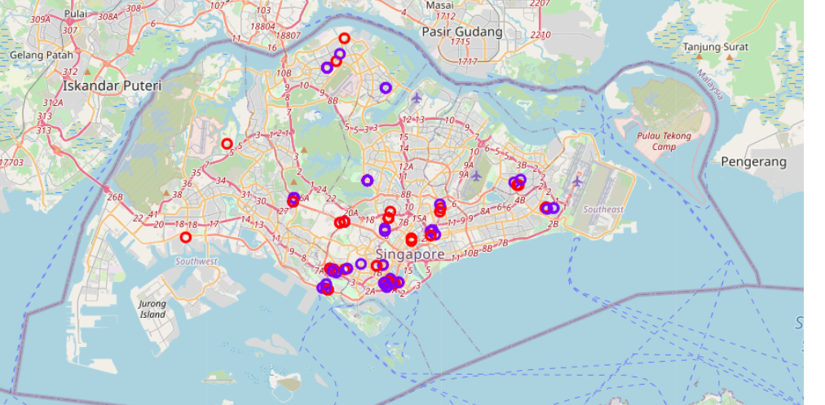
Venues Location after clustering. We have choosen a limited number

Slide 17
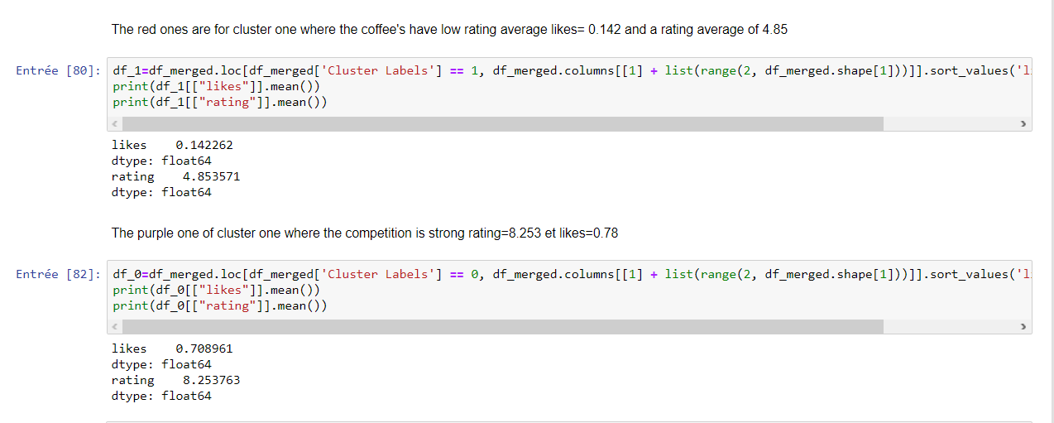

Slide 18
We can that the K-means algorithms has successfully classified coffee shops
Based on their rating and likes. So the one who wants to start the business of a coffee shop should target the neighbors shown on the map with coffee shop of low rating.

